Slide 1

Predicting & Enhancing Employee Performance Through HR Analytics
Jacob Brooks, Cali Hugelen, Edith Tache and Remington Webb
June 30, 2024

Slide 2

Agenda
Introduction
Method/Analysis
Model Summary
Conclusion

Slide 3
Introduction

Slide 4

Organizations aim to boost productivity and retain top talent in today's competitive business landscape. HR analytics plays a crucial role by leveraging data to optimize employee performance, improve recruitment strategies, and assess training effectiveness
Business Problem
Hypotheses
What are the key predictors of employee performance?
KPIs met, previous year ratings, and average training scores are key predictors.
How does the recruitment channel affect employee performance?
What is the impact of training programs on employee performance?
Recruitment channels significantly impact performance.
Training program participation improves performance

Slide 5
Project Goals
Identify key predictors of employee performance.
Assess the impact of different recruitment channels on employee performance.
Evaluate the effectiveness of training programs on employee performance.
Develop a predictive model to forecast employee performance.
Provide actionable recommendations for HR strategies to improve performance and retention.

Slide 6

Dataset and Key Features
Dataset:
“Employee’s Performance for HR Analytics” sourced from Kaggle
Features:
Employee ID: Unique identifier for tracking performance.
Department: The department in which the employee works.
Region: Geographical location of the employee.
Education: Employee's educational background.
Gender: Gender of the employee.
Recruitment Channel: Source of recruitment.
Number of Trainings: Number of training programs attended.
Age: Age of the employee.
Previous Year Rating: The performance rating of the prior year.
Length of Service: Number of years the employee has worked in the company.
KPIs Met More Than 80: Number of key performance indicators met.
Awards Won: Number of awards won.
Average Training Score: Average score from training programs.

Slide 7
Method/Analysis

Slide 8
Methods/Analysis – Data Loading & Preparation
Data Loading
Loaded data into the Google Colab environment.
Missing Values Handling
Categorical variables filled with mode.
Numerical variables filled with the median.
Summary Statistics
Conducted summary statistics.
Reviewed unique values for data integrity.

Slide 9
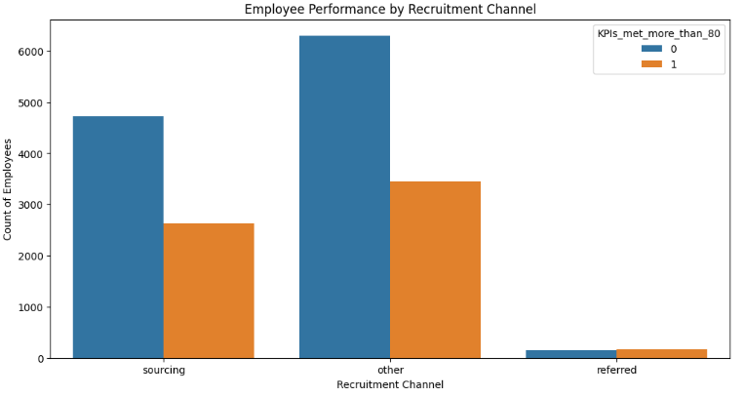
Methods/Analysis – Exploratory Data Analysis (EDA)
Performance by Recruitment Channels: Bar plot shows performance variation across channels

Slide 10
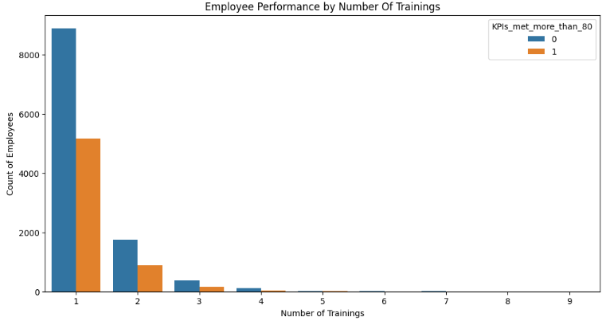
Methods/Analysis – Exploratory Data Analysis (EDA)
Performance by Number of Trainings: Bar plot illustrates the relationship between training programs and performance.

Slide 11
Methods/Analysis – Statistical Tests
ANOVA Tests
Recruitment Channels:
Significant impact on performance (p <0.001)
Training Programs:
Significant impact on performance (p < 0.001)

Slide 12
Model Summary

Slide 13
Models Used
Hyperparameter Tuning
Logistic Regression
Random Forest
Gradient Boosting
Support Vector Machine (SVM)
GridSearchCV tuning used on Gradient Boosting Model to optimize parameters:
learning_rate
max_depth
min_samples_leaf
min_samples_split
n_estimators
subsample

Slide 14
Model Performance
Model | Accuracy | Precision (Class 0) | Precision (Class 1) | Recall (Class 0) | Recall (Class 1) | F1 Score (Class 0) | F1 Score (Class 0)
Logistic Regression | 0.715 | 0.74 | 0.64 | 0.87 | 0.43 | 0.80 | 0.52
Random Forest | 0.707 | 0.73 | 0.63 | 0.86 | 0.42 | 0.79 | 0.50
Gradient Boosting | 0.718 | 0.73 | 0.66 | 0.89 | 0.41 | 0.80 | 0.50
SVM | 0.708 | 0.72 | 0.67 | 0.91 | 0.34 | 0.80 | 0.45
Gradient Boosting achieved the highest accuracy (0.718 after tuning).
*Class 0 - Not Met KPIs / Class 1 – Met KPIs

Slide 15
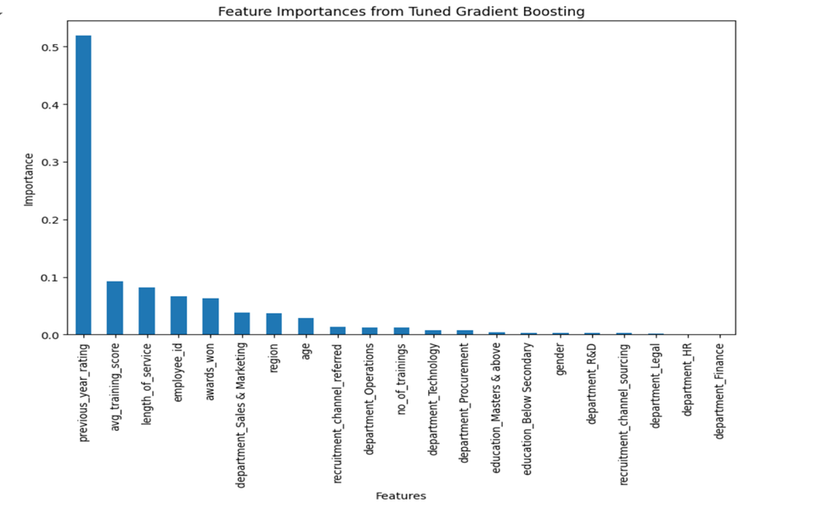
Explanation – Feature Importance
Tuned Gradient Boosting provides insights into key predictors of employee performance. The following top 3 features are the best predictors of employee performance.
Previous year rating
Average Training Score
Length of Service

Slide 16
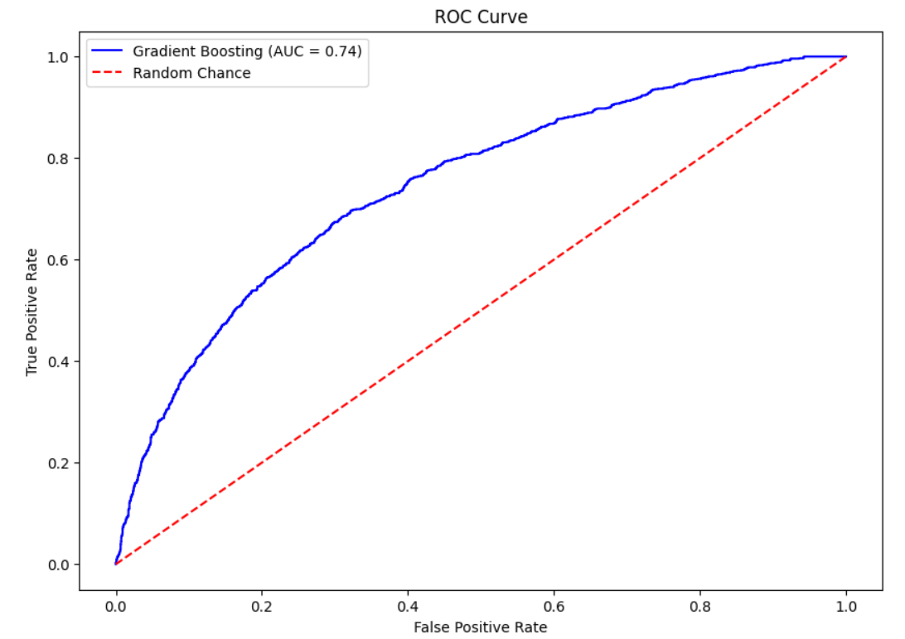
Explanation – ROC Curve
The ROC curve illustrates the trade-off between a true positive rate (sensitivity) and a false positive rate (1 - specificity).
The ROC curve is above the diagonal, indicating that the model performs better than random guessing.
The ROC curve and AUC value of 0.74 suggests that the Gradient Boosting model best predicts the target variable.

Slide 17
Conclusion

Slide 18
Summary of Key Findings
Top Performance Predictors:
Previous year ratings, average training scores, length of service.
Recruitment Channels Impact:
‘Other’ and ‘Referred’: Balanced Performance
‘Sourcing’: More low performers.
Training Program Effectiveness:
Focus on quality and relevance.

Slide 19
Practical Applications
Optimize Recruitment:
Strengthen high-performing channels.
Improve sourcing strategies.
Enhance Training:
Tailored, interactive, continuous learning.
Leverage Key Performance Predictors
Improve performance reviews and targeted interventions.
Performance Monitor and Feedback
Regular check-ins, 360-degree feedback, performance dashboards
Implement the Predictive Model
Apply Gradient Boosting Model
Integrate, update, and retrain regularly.

Slide 20
Thank You!

